Slide 1
Part 1b. Social classes
Capitalist class.
Working class.
Middle classes.

Slide 2
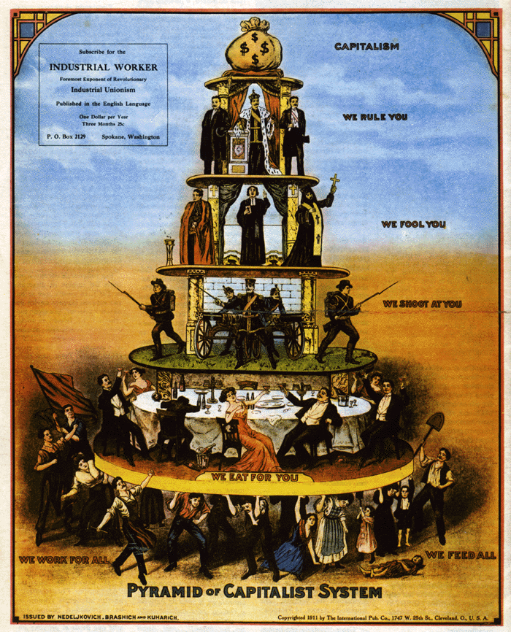
How do the 1% rule?
Ideology.
Manufacturing consent.
Force and repression.

Slide 3
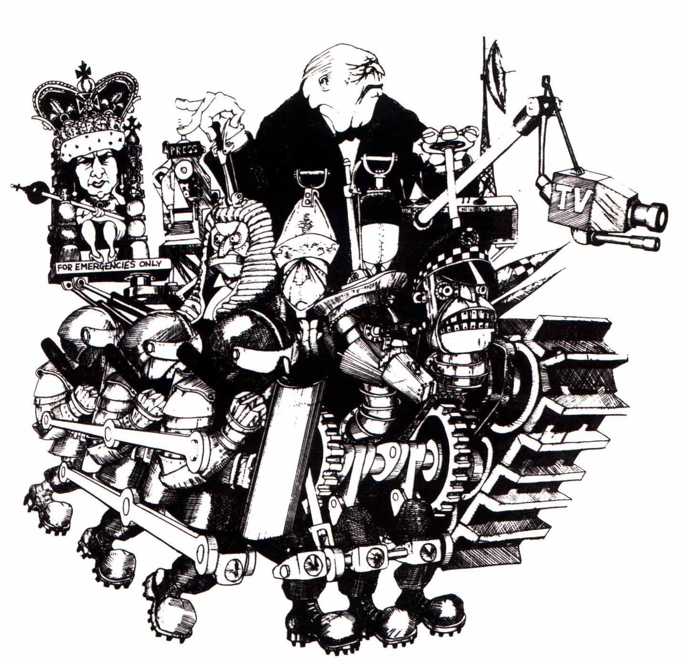
What is the state?
Ultimate guardian of class rule.
What are the key institutions of the state?
Where did it come from?
What is the alternative?

Slide 4
Can capitalism be reformed?
Reforms vs reformism.
Welfare state.
Can there be a just & humane capitalism?
New system needed.

Slide 5
The socialist alternative
Economy brought under social ownership and control.
Basis for profound social change.

Slide 6
Objections to socialism
It will never happen.
Human nature: greed is innate.
Will stifle individuality.
Modern economy too complex to plan.

Slide 7
Fight for socialism
Things look daunting but the struggle will decide.
What each of us does makes a difference.

